Slide 1

NBC Case Competition
Date Presented
01st June 2024

Slide 2

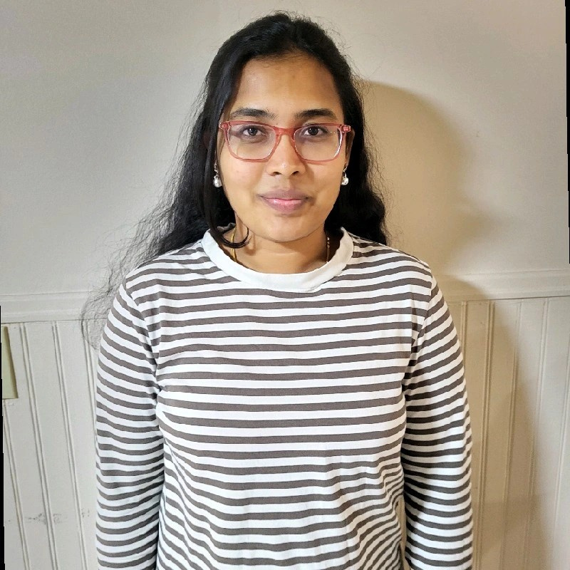

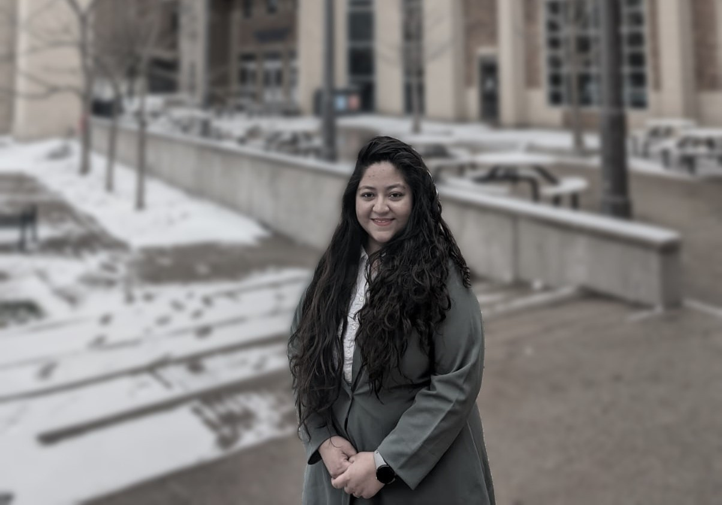
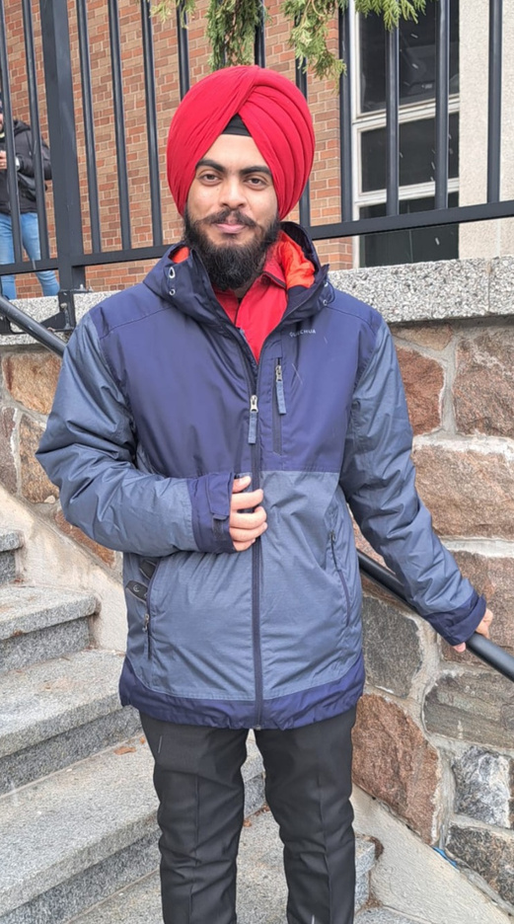

Our Team
Nikhitha Varanasi
Kaarthikheyen Vadivel
Anika Nawar
Jaidev Singh

Slide 3
Agenda
NBC Overview
Region Overview
Regional Geographical Trends
Regional Predictive Analysis
Banking Plans
Top Occupational Analysis
Marketing Strategies
References

Slide 4

Overview of NBC
Canada's 6th largest bank and the leading one in Quebec
Personal
Commercial Banking
Wealth Management and Financial Markets
Values in Action:
Empowerment
Partnership
Agility
Founded in 1859 and headquartered in Montreal
$424 B in Assets
$10.2 B Total Revenue
$3.3 B Net Income
31,243 Employees
2.8 Million Clients
462 branches
2,106 ABM’s

Slide 5
WINDSOR

Slide 6
Windsor Region Overview
Total Population
Age Distribution
Income Distribution
0 to 14 years: ​52,635
15 to 64 years: ​210,375
65 years and over: 60,590​
Average Age: 43.4 years​​
Low-Income: 76,420 (Under $30,000/year)​
Middle-Income: 104,940​ ($30,000 to $99,999/year)​
High-Income: 32,340 ($100,000 and over/year)​
Population (2024): 317,439
Population (2030):
~345,000

Slide 7
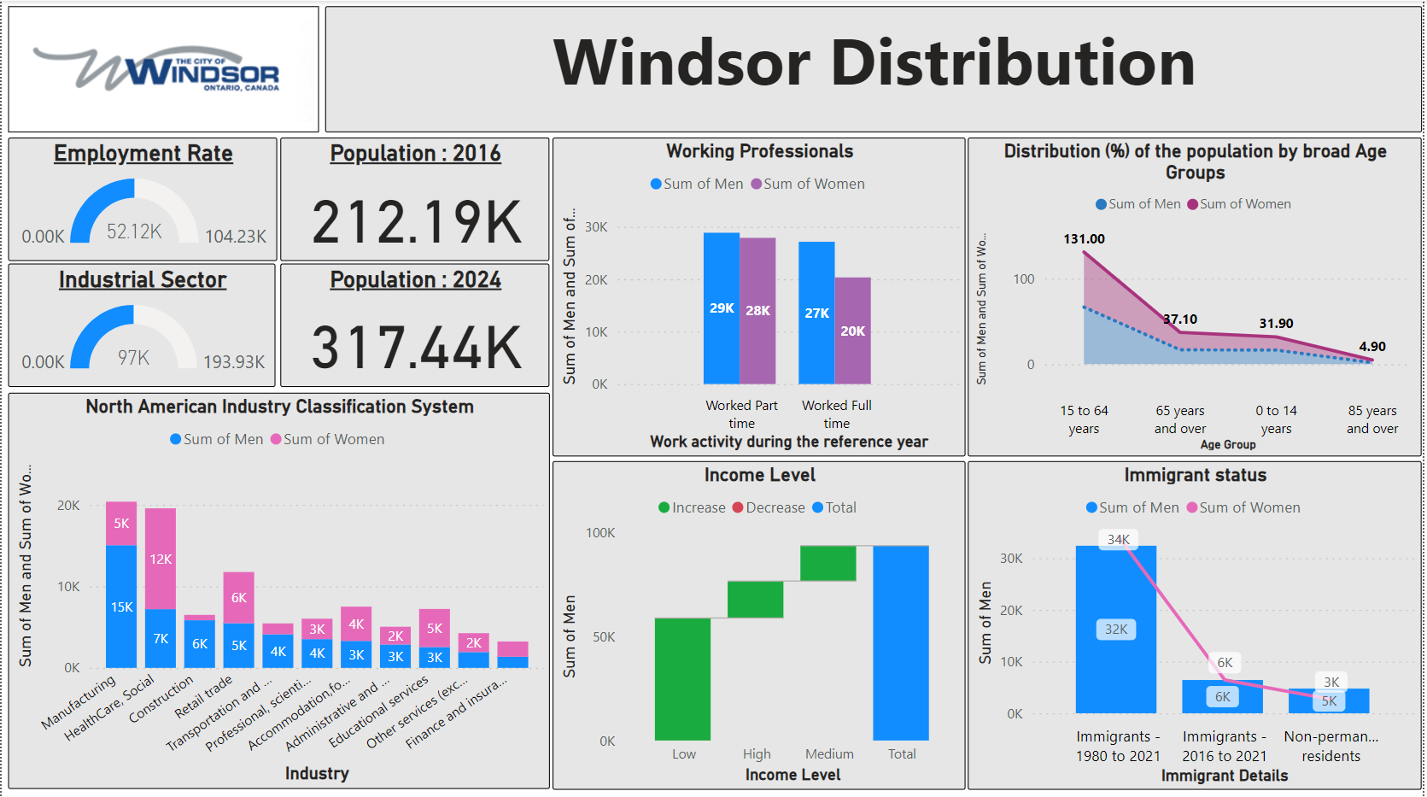
Geographic Trends
Windsor Region
Source: Made in Power BI

Slide 8
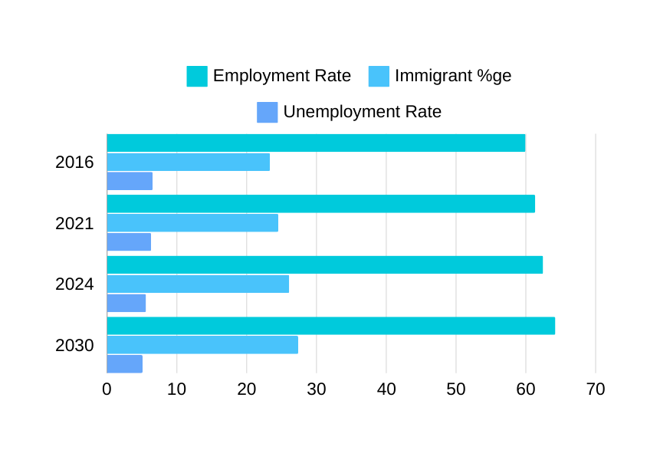
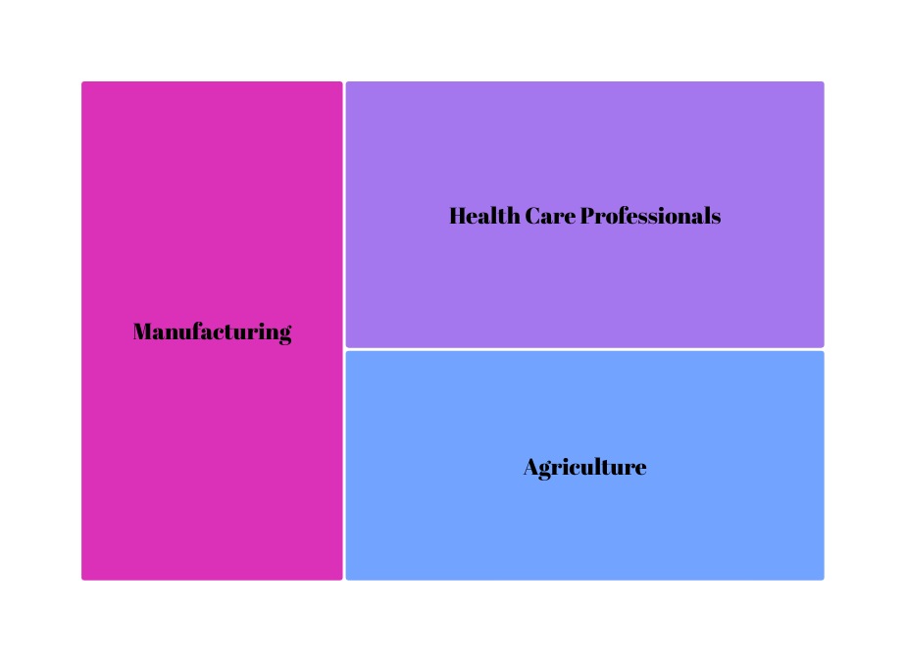

Prediction Analysis
Windsor Region
Emp. Rate: 59.95%
Immigrant : 23.33%
Employment& Immigration Rate Increase dramatically over years
Unemployment rate decreases from 2016 to 2024 and is slightly decreasing and might be the same in 2030
6.5%
61.35%
24.5%
6.35%
62.4%
26.1%
5.36%
~ 64.31%
~ 27.28%
~5.1%
Importance of Manufacturing, and increased Health care needs.
As Lemington is famous for Agricultural estate.. it stands in 3rd position
Source: Made in Power BI

Slide 9
Banking Plans for HEALTHCARE PLAN
PEERLESS POINTS OF OTHER BANKS
SCOTIABANK -
Comprehensive Credit Card Rewards
Specialised Programs
CIBC -
Cashback on Mortgages and Promotional Rates on Savings Accounts
DIY and Managed Investment Options
RBC -
Holistic Financial Planning and Practice Management
Mental Health Resources and Estate Planning
PEERLESS POINTS OF NBC
RECOMMENDATIOSN FOR NBC
Telemedicine and Legal Assistance
No Annual Fee World Elite® Mastercard®:
Unlimited Transactions and Withdrawals
Enhance Credit Card Rewards
Introduce Specialized Programs
Expand Investment Solutions
Add More Immediate Financial Incentives

Slide 10
WATERLOO

Slide 11
Waterloo Region Overview
Total Population
Age Distribution
Income Distribution
Population(2024): 660,000
Expected (2030):
~715,000
0-14 years: Approximately 99,100
15-64 years: Approximately 465,600
65+ years: Approximately 105,400
Average Age: 44 years​
Low-Income: 95,695 (Under $30,000/year)​
Middle-Income: 345,015 ($30,000 to $99,999/year)​
High-Income: 45,190 ($100,000 and over/year)​

Slide 12
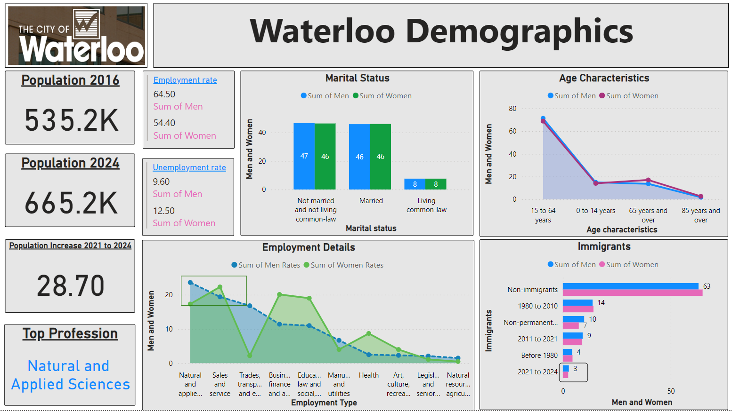
Geographic Trends
Waterloo Region
Source: Made in Power BI

Slide 13
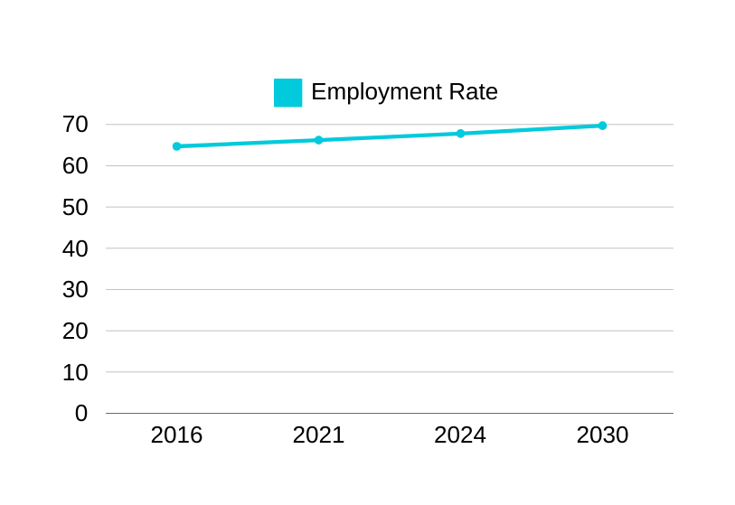
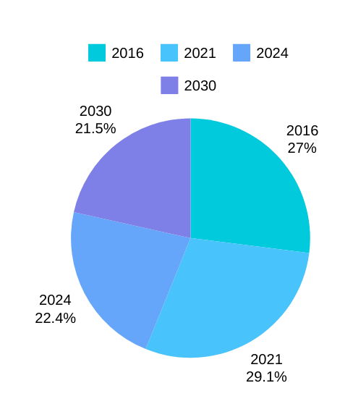
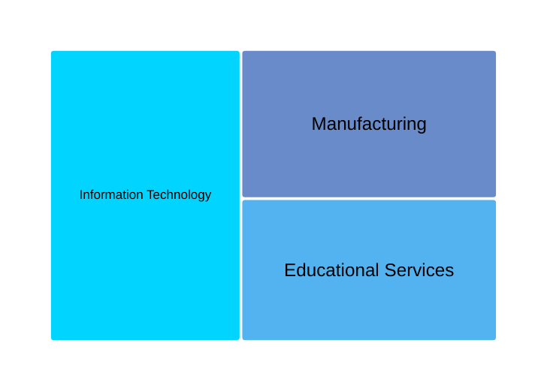

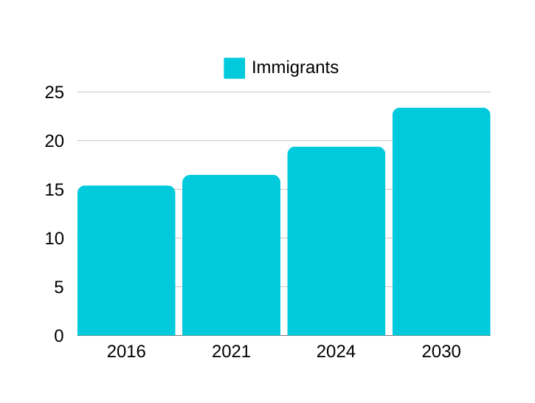
Predictive Analysis
Waterloo Region
~ 69.8%
Employment Rate is increasing year-over-year by ~3%
62.6%
65.8%
67.4%
Unemployment Rate is higher in 2020, because of the pandemic inflation
Tech-related roles is the top Profession in Waterloo
~ 22.7%
19.4%
Immigrants are increasing majorly
16.5%
15.4%
Source: Made in Power BI

Slide 14
Banking Plans for IT
PEERLESS POINTS OF NBC
PEERLESS POINTS OF OTHER BANKS
RECOMMENDATION FOR NBC
Value-Added Services
Overdraft Protection
No Fixed Monthly Fees
Credit Card Rewards
Mortgage Flexibility
Account Waiver Options
Promotional Rates
Enhance Credit Card Rewards
Flexible Mortgage Options

Slide 15
MIDDLESEX

Slide 16
Middlesex Region Overview
Total Population
Age Distribution
Income Distribution
Population(2024): 511,570
Population (2030):
~ 630,000
0 to 14 years: ​79,020
15 to 64 years: ​318,240
65 years and over: 74,950​
Average Age: 40.7 years​​
Low-Income: 123,535 (Under $30,000/year)​
Middle-Income: 177,635​ ($30,000 to $99,999/year)​
High-Income: 29,880 ($100,000 and over/year)​

Slide 17
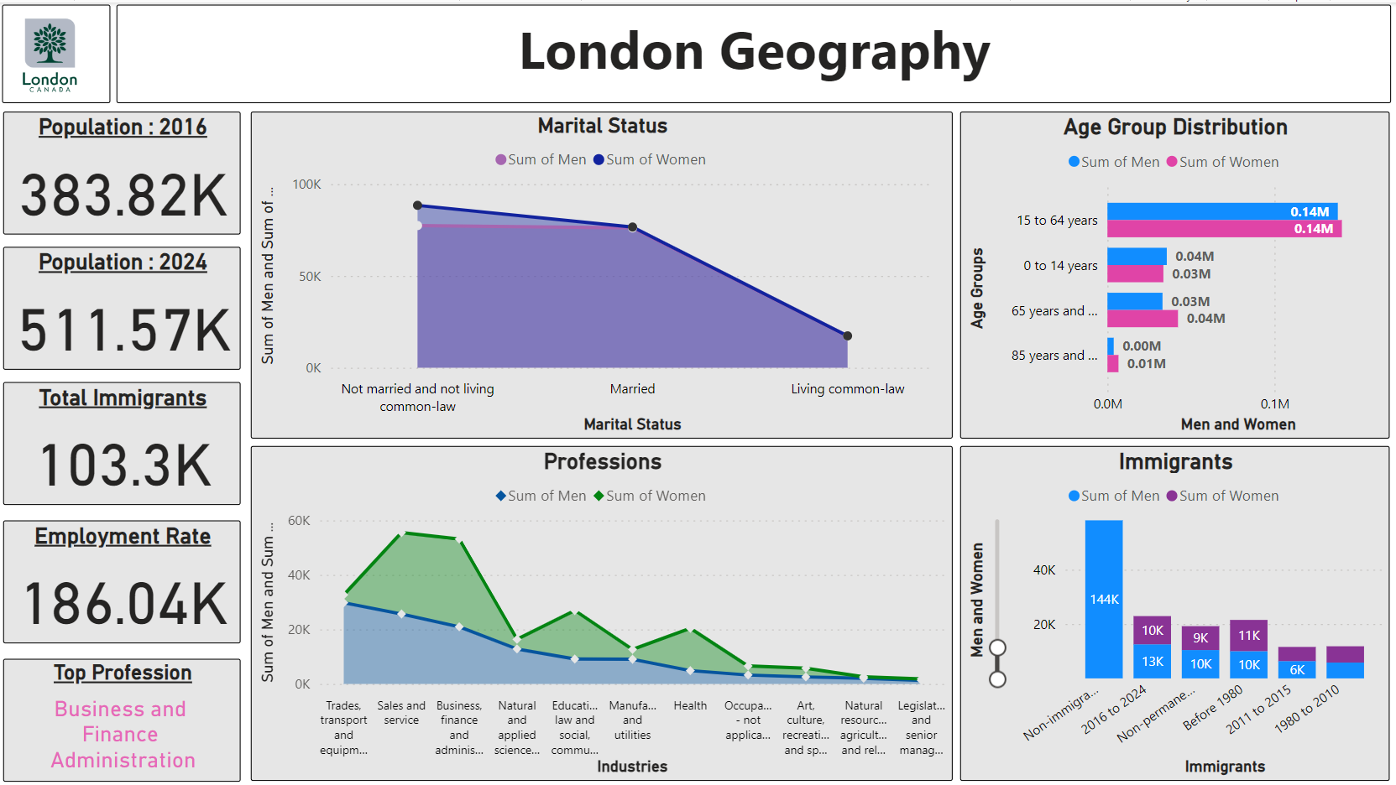

Geographic Trends
Middlesex Region
Source: Made in Power BI

Slide 18
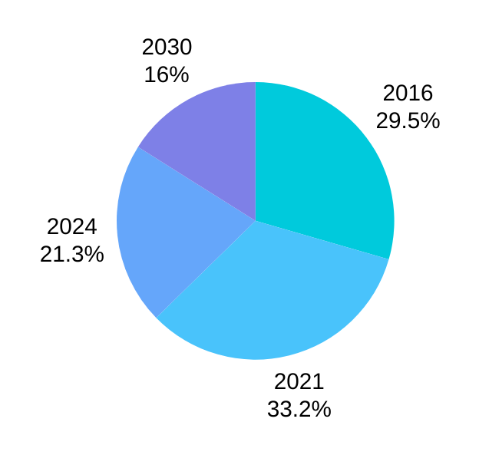
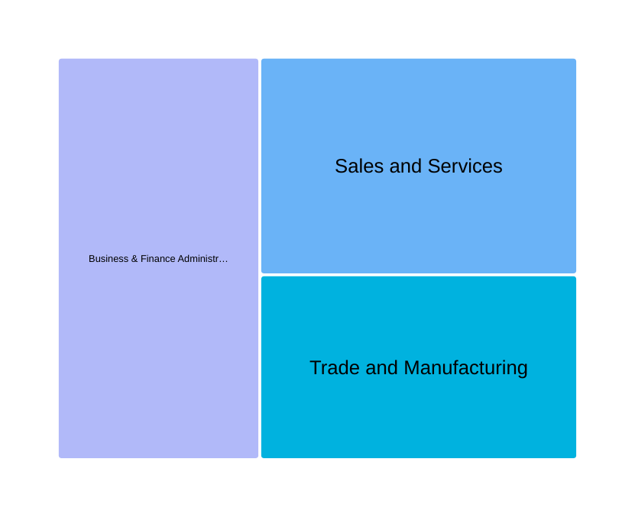

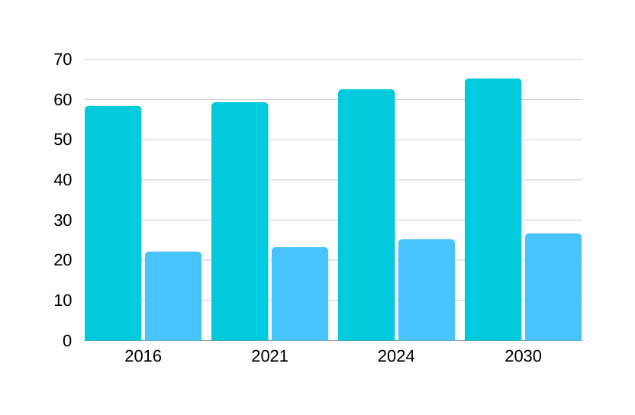
Predictive Analysis
Middlesex Region
Prediction of Unemployment Rate will decrease to ~4.5% from 2024 to 2030
Sales and Services, Business and Finance Administration are the leading in London
~65.4%
62.6%
58.5%
56.5%
~26.4%
The Employment Rate and Immigrants are predicted to Increase by ~ 3.6 to 6.7 %in 2030
23.8%
24.1%
20.6%
Source: Made in Power Bi

Slide 19
Banking Plans for
FINANCE, MANAGEMENT & ADMIN PLANS
PEERLESS POINTS OF NBC
PEERLESS POINTS OF OTHER BANKS
RECOMMENDATION FOR NBC
No fixed monthly fees for up to 3 bank accounts
Unlimited branch and electronic transactions
Valuable added services: legal assistance, telemedicine
Dedicated specialists
Customized business accounts
Wider range of value-added services tailored for professionals
Value-added services tailored for professionals

Slide 20
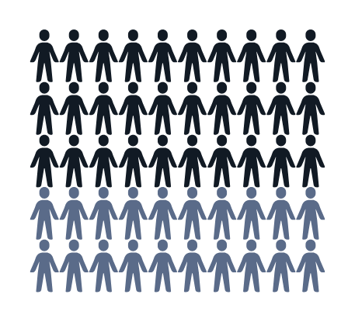
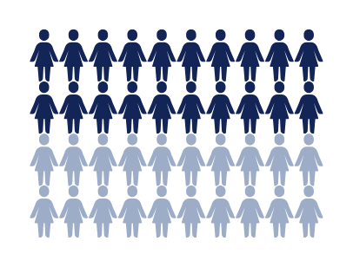
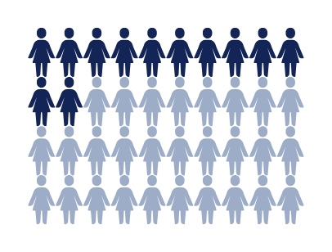
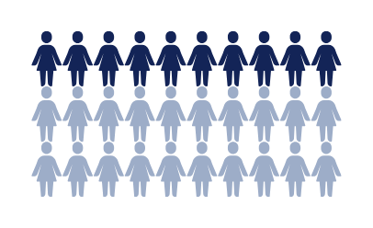

Top Professions
34%
28%
27%
26%
21%
of people are from Sales, Services
of People are from
Health Care
of people are from
Trade, Transport and Equipment
Manufacturing Workers
of people are from
Information Technology
of people are from
Business , Finance Administration

Slide 21

Promoting Healthcare Plan
NBC Wellness Marathon on National Health Day
Windsor-Essex Region

Slide 22



Objective: Engage healthcare professionals and the Windsor-Essex community in a wellness-focused marathon event to promote NBC Bank’s healthcare plans and services.
Date - April 7th (National Health Day)

Slide 23
EVENT DETAILS
INCENTIVES
Location: Scenic routes in Windsor-Essex, including riverfront trails.
Participation: Open to healthcare professionals, their families, and the general public.
Activities:
5K and 10K Runs
Health Check-Up Booths
Wellness Workshops (financial health, stress management, nutrition)
Kids' Fun Run
Prizes:
Participation Medals
Top Finishers' Prizes (Gift cards)
Grand Prize (Wellness retreat for two)
Raffle Prizes (Financial consultation packages, fitness gear, NBC Bank merchandise)
Social Media Engagement:
Real-Time Leaderboard
Social Media Challenges with #NBCWellnessMarathon

Slide 24
MARKETING & PROMOTION
Social Media:
Organic and Paid Posts (Facebook, Instagram, Twitter)
Event Pages for RSVPs and updates
Community Collaborations:
Partnerships with Local Hospitals and Clinics
Collaborations with 5-10 Local Influencers
Media Coverage:
Press Releases to Local Newspapers, Radio Stations, TV Channels
Flyers in High-Traffic Areas (Gyms, Healthcare Facilities, Community Centers)

Slide 25
BUDGET
TIMELINE
Preparation Phase (Jan 1 - Feb 28): Plan logistics, secure permits, finalize partnerships, design and order merchandise, develop social media strategy.
Promotion Phase (Mar 1 - Apr 6): Launch social media campaigns, distribute flyers, collaborate with influencers and local media, open online registration.
Event Day (Apr 7): Execute marathon event, provide real-time updates and interact with participants.
Post-Event Phase (Apr 8 - Apr 21): Share event highlights, follow up with participants, promote NBC Bank’s healthcare plans, analyze campaign performance and metrics.
Event Logistics: $15,000
Marketing and Promotions:
Social Media Ads: $3,000
Influencer Partnerships: $5,000
Flyers and Posters: $2,000
Prizes and Giveaways:
Participation Medals: $1,500
Top Finishers' Prizes: $600
Grand Prize: $1,000
Raffle Prizes: $2,000
Miscellaneous:
T-Shirts and Merchandise: $2,000
On-Site Logistics and Staffing: $4,000
Total Budget: $36,100

Slide 26

Promoting Finance Plan
Engage, Solve, Win: NBC's Financial Puzzle Challenge for Middlesex Minds
MIDDLESEX REGION

Slide 27
Objective:
PUZZLE GAME DESIGN:
Engage finance and admin professionals with financial-themed puzzles on Facebook and TikTok to promote NBC Bank's services in the Middlesex (Ontario) region.
Concept: Series of financial puzzles (budget balancing, investment simulations, trivia).
Platform: NBC Bank’s Facebook and TikTok pages.
Frequency: New puzzle daily for one week.
Interaction: Users submit answers via comments or direct messages.
Target Audience:
Finance and admin professionals active on social media in the Middlesex region.

Slide 28

Engagement and Incentives:
Features: Use Facebook’s interactive stories and TikTok’s duet function.
Daily Prizes: Gift cards ($50 each), exclusive content, free consultations.
Grand Prize: iPad or financial planning session (worth $500).
Leaderboard: Encourage competition.
Measurement:
Engagement Metrics: Likes, shares, comments, hashtag usage.
Participation Metrics: Puzzle submissions and direct messages.
Conversion Metrics: Website traffic and consultation bookings.

Slide 29


REACH
Social Media Interactions: Targeting 20% of the population, aiming for 100,000 impressions through organic reach and promoted posts.
Influencer Collaborations: Partner with 5-10 local micro-influencers, each having 10,000-20,000 followers, aiming for an additional reach of 75,000.
User-Generated Content: Encourage at least 300 user-generated posts, potentially reaching 30,000 users.

Slide 30

Budget
root word
Game Development: $2,000 for design and implementation.
Daily Prizes: $350 (7 days x $50 per prize).
Grand Prize: $500.
Influencer Partnerships: $5,000 (10 influencers x $500 each).
Promoted Posts: $2,000 for social media advertising.
Total Budget: $9,850
Financi
er
suffix

Slide 31






PROMOTING IT PLAN
Tech Titans Hackathon Challenge
Waterloo Region

Slide 32



Objective
ENGAGE AND ATTRACT IT PROFESSIONALS IN THE WATERLOO REGION TO NBC BANK'S BANKING PLANS THROUGH A UNIQUE AND COMPETITIVE TECH-ORIENTED CHALLENGE.
Target Audience
IT PROFESSIONALS, SOFTWARE ENGINEERS, DEVELOPERS, AND TECH ENTHUSIASTS IN THE WATERLOO REGION.

Slide 33

Key Elements
Tech-Oriented Challenges:
Design puzzles related to banking, cybersecurity, and software development.
Host challenges on NBC Bank's platform for individual or team participation.
Weekly challenges for three months, fostering engagement and interaction.
Exclusive Rewards:
Offer tech gadgets, software subscriptions, and VIP tickets as prizes.
Partner with local tech companies for additional sponsored prizes and job opportunities.
Highlight winners on social media and NBC Bank's website to foster community.

Slide 34

Key Elements
Interactive Workshops:
Host workshops led by industry experts on blockchain, AI, and cybersecurity.
Provide hands-on experience and insights into tech trends.
Enhance participants' skills and position NBC Bank as a valuable resource.
Networking Events:
Organize meetups for IT professionals to connect and collaborate.
Invite guest speakers from tech companies to share insights.
Strengthen NBC Bank's presence as a supporter of innovation and collaboration.

Slide 35





Budget Allocation
Tech-Oriented Challenges: $8,000
Exclusive Tech Rewards and Prizes: $10,000
Interactive Tech Workshops and Webinars: $7,000
Tech Community Networking Events: $5,000
Total Budget: $30,000
Measurement
Participant Engagement: Registrations, challenge completions, attendance.
Community Impact: Feedback from participants and guest speakers.
Brand Awareness: Increase in visibility and positive sentiment.

Slide 36


CONCLUSION
Manufacturing, Teaching, Sales & Service and Agriculture
Initiation of customized plans for the above sectors.
Display on website and other platforms.

Slide 37
Statistics Canada: Provides comprehensive census data and labor market statistics for various regions across Canada.
Local Economic Reports: Reports from municipal or regional economic development offices that provide insights into employment trends, key industries, and economic initiatives.
Ontario Government Reports: Publications and data from the Ontario Ministry of Labour, Training and Skills Development, and related agencies.
References

Slide 38
Thank you ☺

Slide 39
Marketing Plans (General)
Digital Marketing
Print Advertisements
Event Sponsorship
Social Media Advertising - Running Targetted ads on Linkedin, Facebook etc.
Content Marketing - Creating and sharing relevant content to attract target customers.
SEO Optimization - Improving the NBC Website’s SCO for better reach.
Sponsorship of Relevant Events - participating in local events relevant to each profession
Advertising in Specialized Publications: Placing ads in journals, newspapers or local magazines specific to each professional group.
Manpower - 1 Digital Marketing Specialist, 1 Content creator, 1 Event Coordinator
Budget (estd.) - $18000 (Waterloo), $10000 (London), $8000 (Windsor-Essex)

Slide 40
Marketing Plans (Region-wise)
Windsor-Essex
(Healthcare)
Middlesex (Business, Finance & Admin)
Waterloo (IT)
Business Networking Events: Sponsoring and participating in business networking events to engage directly with finance and administration professionals.
Healthcare Conferences and Seminars: Sponsoring and attending healthcare-specific events to promote NBC’s plans directly to healthcare professionals.
Influencer Partnerships: Collaborating with local tech influencers and bloggers to review and endorse NBC’s banking plans.
Manpower - 1 Marketing Coordinator, 2 Event Coordinators
Budget (estd.) - $5000 (Waterloo), $10000 (London), $8000 (Windsor-Essex)

Slide 41
Sales Plan (General)
PARTNERSHIPS
WORKSHOPS & SEMINARS
REFERRAL PROGRAMS
Referral Programs: Introducing referral programs to use existing customer networks.
Partnerships with Local Organizations: Establishing partnerships with local companies, institutions, or associations related to the target professions.
Hosting Educational Events: Conducting webinars, workshops, or in-house sessions tailored to the financial needs of the target professionals.
Manpower - 2 Sales Representatives (per region), 1 Financial Advisor (per region), 1 Customer Service Representative
Budget (estd.) - $5000 (Waterloo), $2000 (London), $3000 (Windsor-Essex)

Slide 42
Sales Plans (Region-wise)
Windsor-Essex
(Healthcare)
Middlesex (Business, Finance & Admin)
Waterloo (IT)
In-House Financial Planning Sessions: Offering financial planning sessions directly at healthcare institutions to engage professionals on-site.
Influencer Partnerships: Collaborating with local tech influencers and bloggers to review and endorse NBC’s banking plans.
Direct Outreach: Phonecalls and visits to introduce NBC Healthcare plans
Dedicated Relationship Managers: Assigning relationship managers to provide personalized service and support.
Manpower - 4 Sales representatives, 1 Financial Advisor, 2 relationship Managers

Slide 43

Leamington Overview
Total Population
Age Distribution
Income Distribution
0 to 14 years: 5,190 ​
15 to 64 years: 17,690 ​
65 years and over: 5,295
Average Age: 42 years​​
Low-Income: 5,695 (Under $30,000/year)​
Middle-Income: 8,015 ($30,000 to $99,999/year)​
High-Income: 5,190 ($100,000 and over/year)​
Approximately 35,730

Slide 44
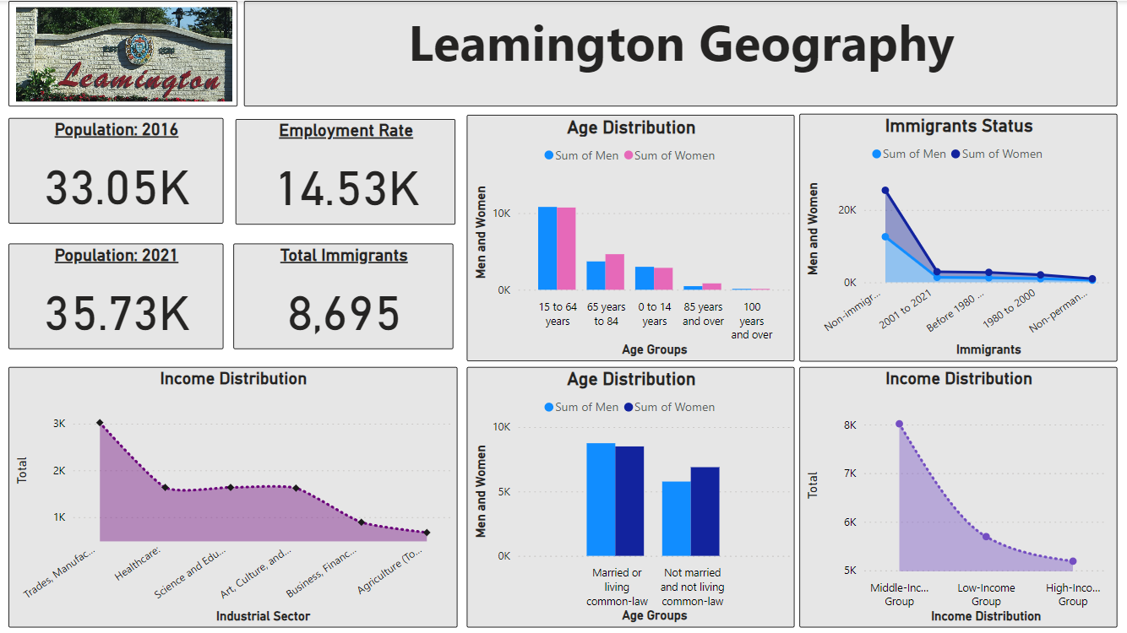
Geographic Trends
Leamington
Source: Made in Power BI

Slide 45
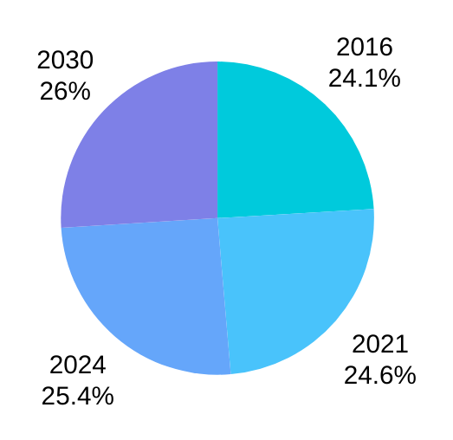
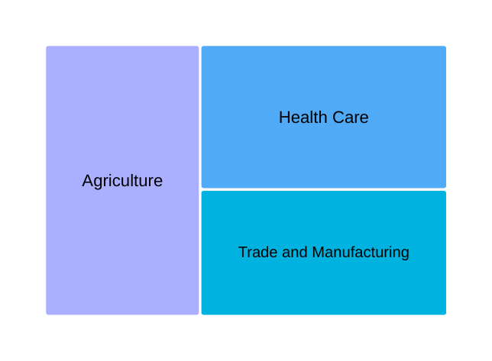
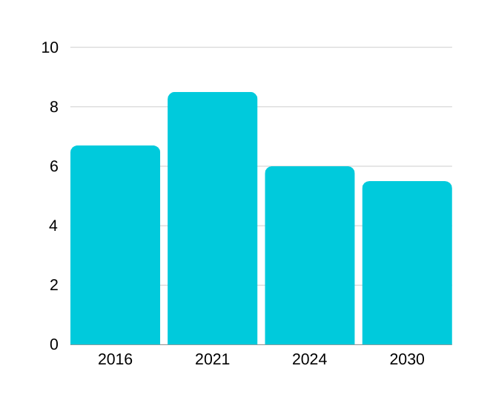
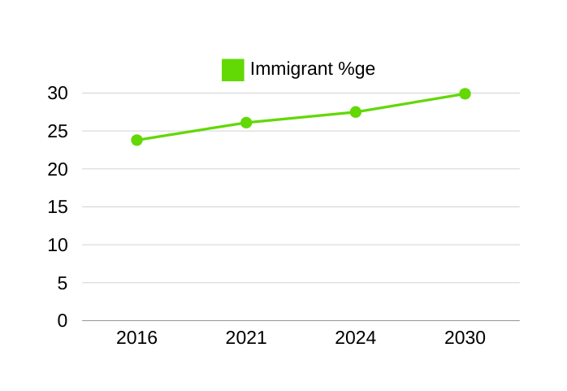
Predictive Analysis
Leamington
Prediction of Employment Rate in 2030 would be ~26.4% to 27.5%
Agriculture(Tomato production) is the top profession in Leamington
The Immigrant rate is predicted to increase in 2030
As Leamington population is Less, the unemployment rate is less
Source: Made in Power Bi

Slide 46
Kingsville Overview
Total Population
Age Distribution
Income Distribution
0 to 14 years: 3,570 ​
15 to 64 years: 12,950​ ​
65 years and over: 4,665​
Average Age: 43 years​​
Low-Income: 10,380​ (Under $30,000/year)​
Middle-Income: 6,150​ ($30,000 to $99,999/year)​
High-Income: 1,580​ ($100,000 and over/year)​
Approximately 22,119

Slide 47
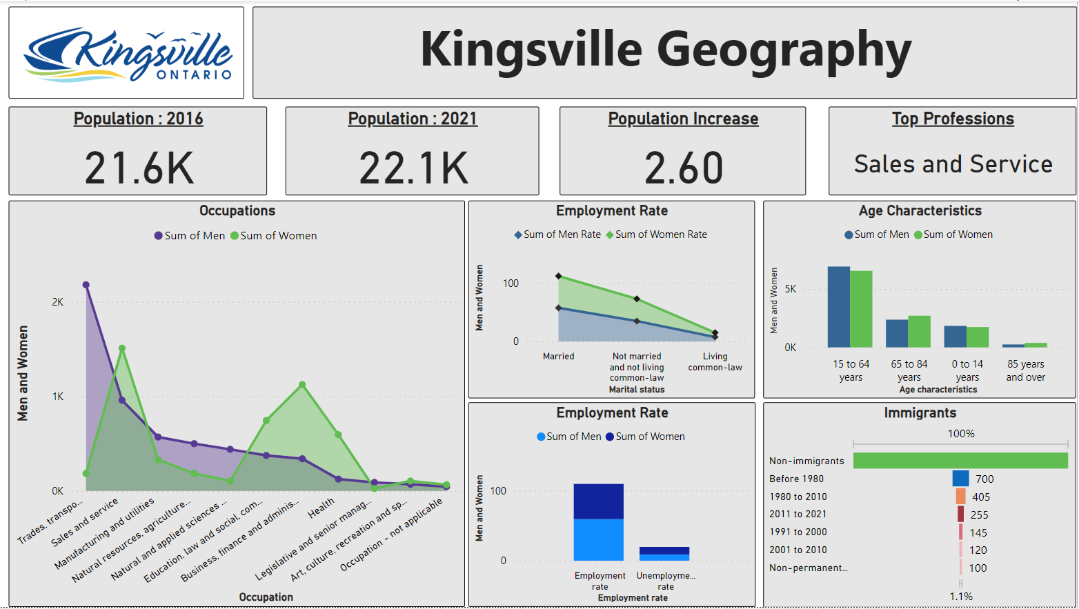
Geographic Trends
Kingsville
Source: Made in Power BI

Slide 48
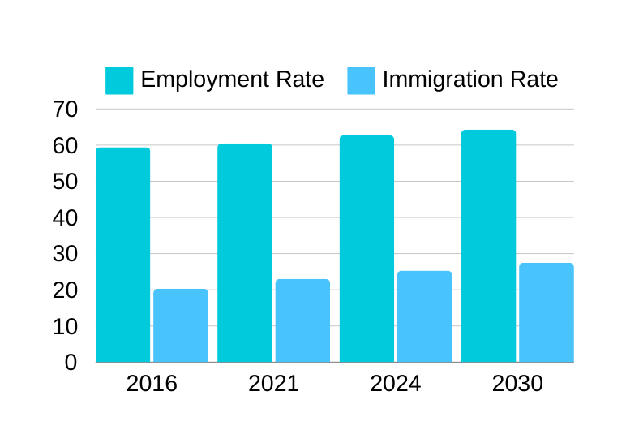
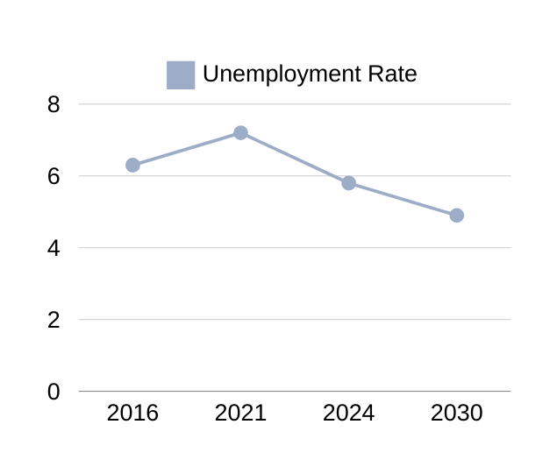
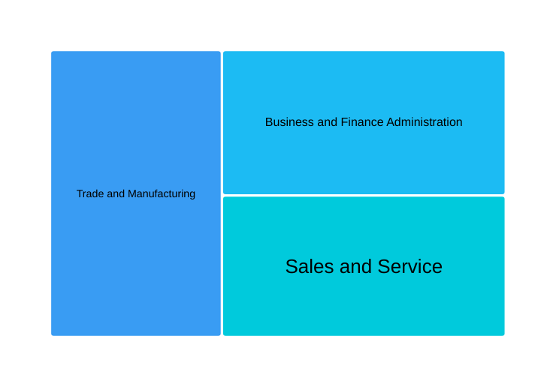
Industry Analysis
Kingsville
Predicted to increase to around 64.0% ~ 66.0% economic growth
27.0% to 29.0% as Kingsville attracts immigrants (growing job market & supportive community infrastructure)
Decrease to ~5.0%, (economic stability,employment policies)
Sales and Service is the top profession in Kingsville
Source: Made in Powerbi

Slide 49
Kitchner Overview
Total Population
Age Distribution
Income Distribution
0 to 14 years: ​44,905
15 to 64 years: ​174,175
65 years and over: 37,765​
Average Age: 39 years​​
Low-Income: 69,690 (Under $30,000/year)​
Middle-Income: 111,735​ ($30,000 to $99,999/year)​
High-Income: 18,880 ($100,000 and over/year)​
Approximately 272,220

Slide 50
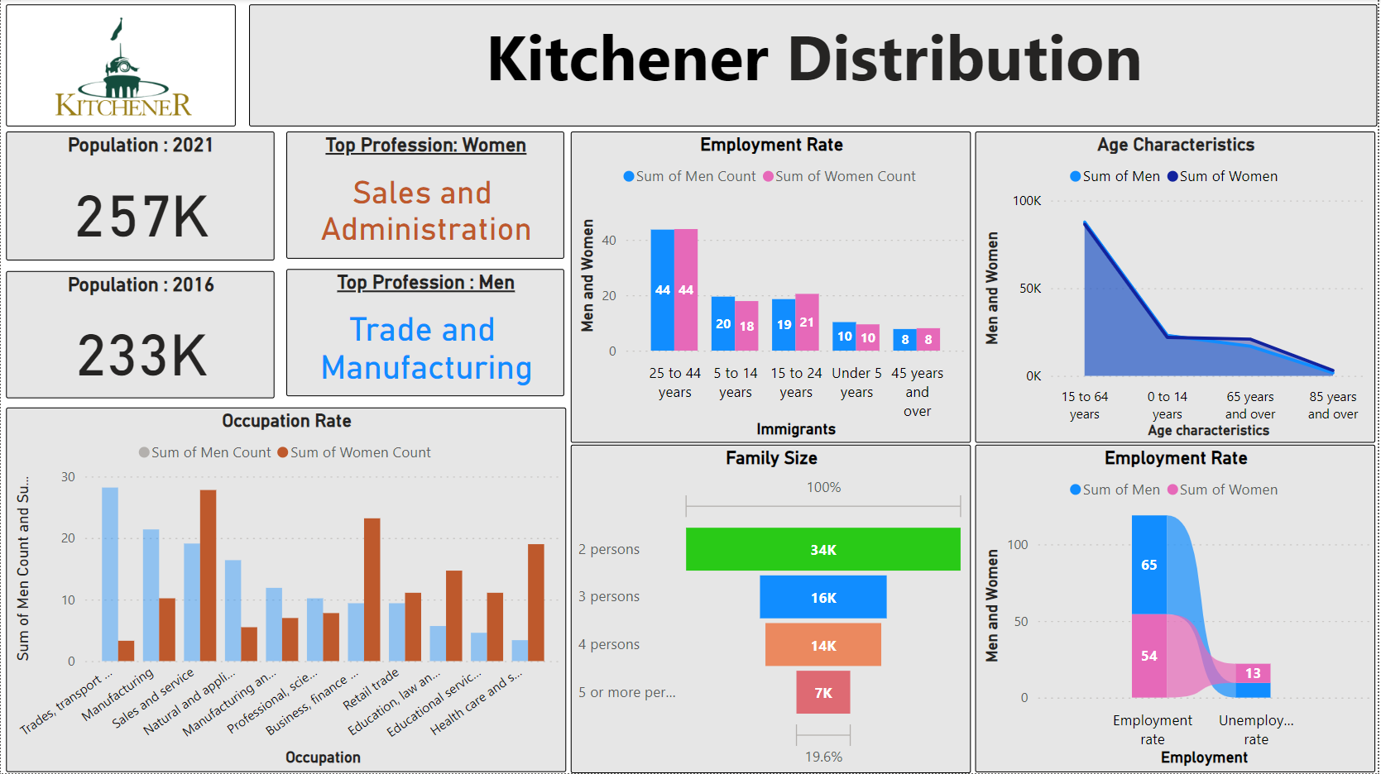
Geographic Trends
Kitchener
Source: Made in Power BI

Slide 51
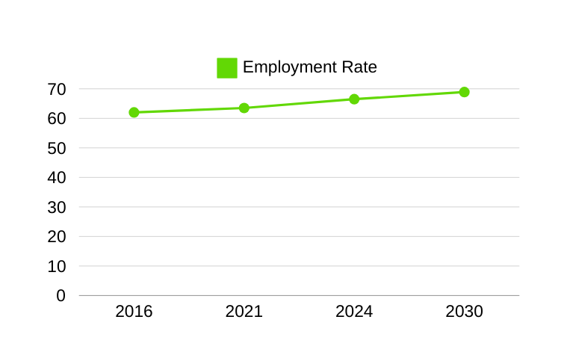
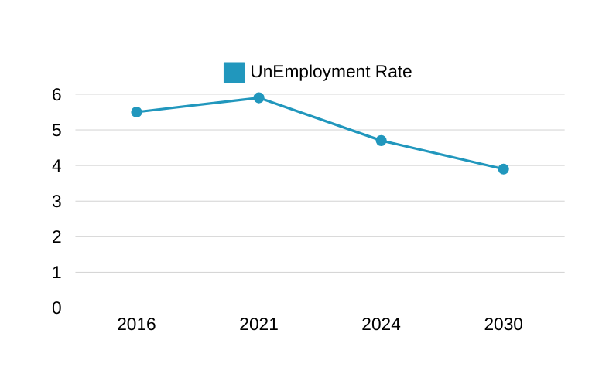
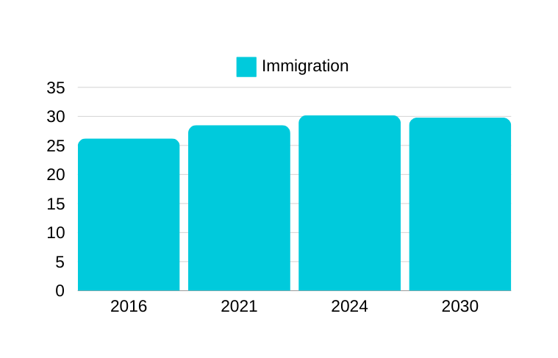
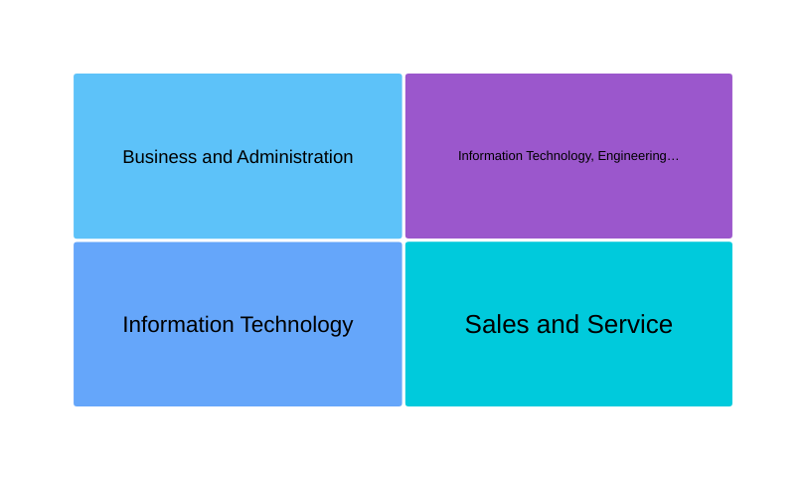
Prediction Analysis
Kitchener
Unemployment is higher in 2021 and is predicted to decrease hugely by 2030
Amongst the Provinces Kitchener has more scope in Information and Technology
Source: Made in Power BI

Slide 52
Waterloo Overview
Total Population
Age Distribution
Income Distribution
Approximately 132,519
0 to 14 years: ​17,645
15 to 64 years: ​85,075
65 years and over: 18,685​
Average Age: 39.2 years​​
Low-Income: 35,690 (Under $30,000/year)​
Middle-Income: 45,420​ ($30,000 to $99,999/year)​
High-Income: 14,460 ($100,000 and over/year)​

Slide 53
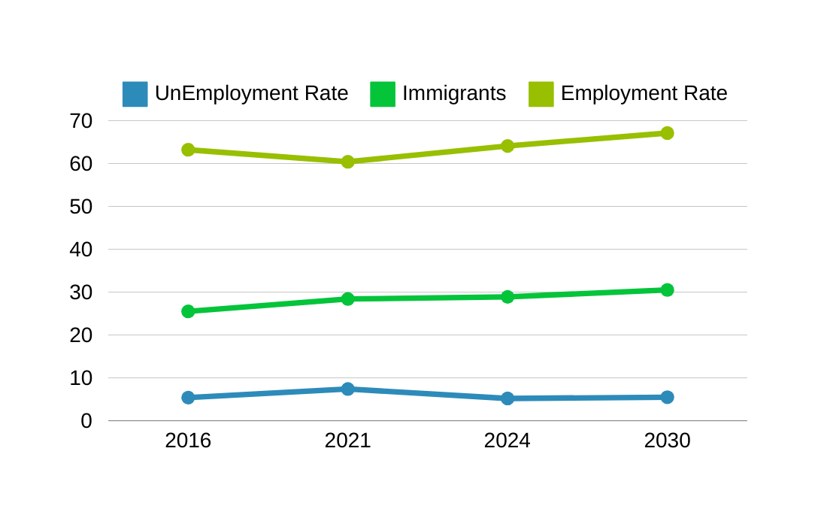

Prediction Analysis
Waterloo
Waterloo is majorly distributed with IT Professional and Technological People
Unemployment Rate of 2016 to 2021 : 7.4 to ~4.6%
Employment Rate of 2030 : ~69% (Predicted)
Immigrants Rate ranges from 33% to 37% of population
Source: Made in Power BI

Slide 54
Guelph Overview
Total Population
Age Distribution
Income Distribution
0 to 14 years: ​23,505
15 to 64 years: ​96,695
65 years and over: 23,500​
Average Age: 40.1 years​​
Low-Income: 37,365 (Under $30,000/year)​
Middle-Income: 63,150​ ($30,000 to $99,999/year)​
High-Income: 13,050 ($100,000 and over/year)​
Approximately 151,421

Slide 55
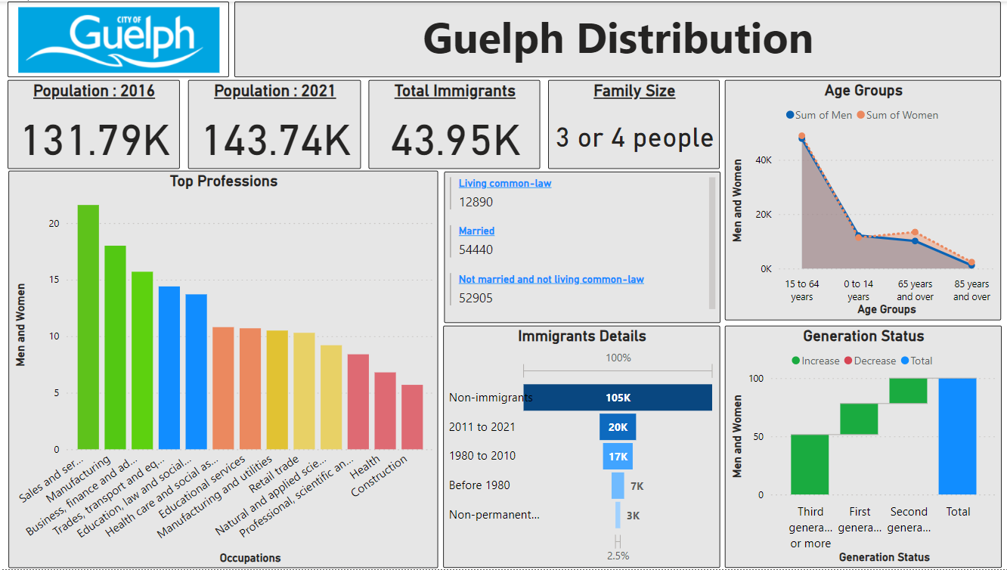
Geographic Trends
Guelph
Source: Made in Power BI

Slide 56
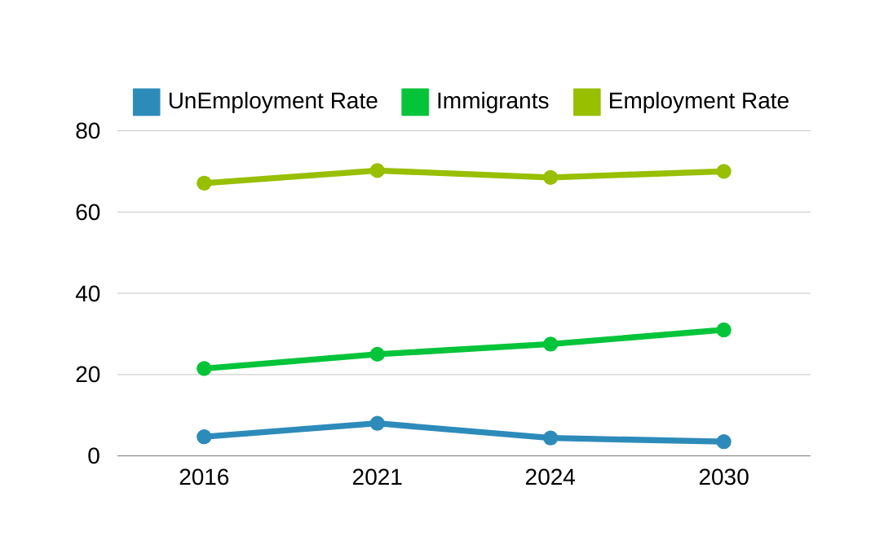
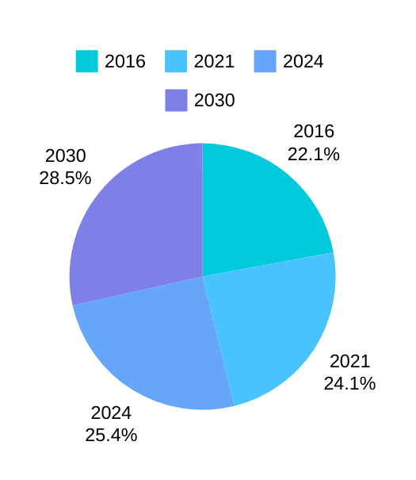
Prediction Analysis
Guelph
Population percentage change, 2016 to 2021 : 9.1
Unemployment Rate of 2016 to 2021 : 4 to 7%
Population percentage change, 2024 to 2030 : 8.6
Employment Rate of 2030 : 70% (Predicted)
Immigrants Rate ranges from 20% to 30% of population
Source: Made in Power BI

Slide 57
Sarnia Overview
Total Population
Age Distribution
Income Distribution
Approximately
72,320
0 to 14 years: ​10,575
15 to 64 years: ​43,795
65 years and over: 17,675​
Average Age: 44.8 years​​
Low-Income: 20,835 (Under $30,000/year)​
Middle-Income: 30,865​ ($30,000 to $99,999/year)​
High-Income: 6,740 ($100,000 and over/year)​

Slide 58
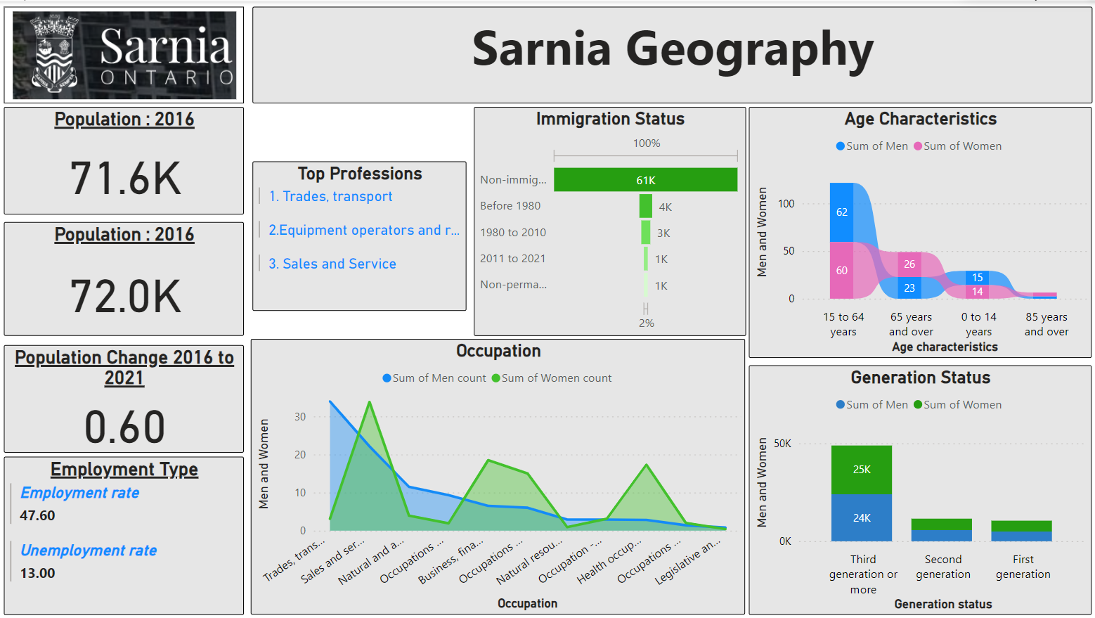
Geographic Trends
Sarnia
Source: Made in Power BI

Slide 59
Brantford Overview
Total Population
Age Distribution
Income Distribution
0 to 14 years: ​17,965
15 to 64 years: ​66,930
65 years and over: 19,755​
Average Age: 41.4 years​​
Low-Income: 30,290 (Under $30,000/year)​
Middle-Income: 46,010​ ($30,000 to $99,999/year)​
High-Income: 5,645 ($100,000 and over/year)​
Approximately 108,544

Slide 60
Marketing Plans
IT Professionals
Healthcare Professionals
Finance, Management & Admin
Advertise through targeted online ads on tech forums
Social media platforms frequented by IT professionals
Partnerships with IT organizations or events.
Advertise through targeted channels such as healthcare industry websites.
Partnerships with medical associations or conferences.
Leverage email campaigns targeting healthcare professionals
Collaborate with influencers in the healthcare field
LinkedIn ads targeting professionals in these field
Hosting webinars or workshops focusing on financial management and administrative

